Slide 1

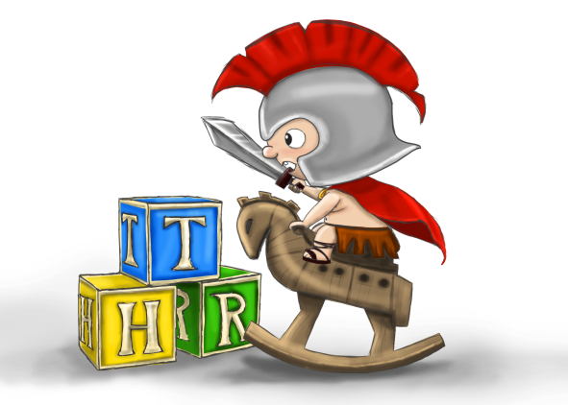
Goldmaster – P300
Felix Günther

Slide 2
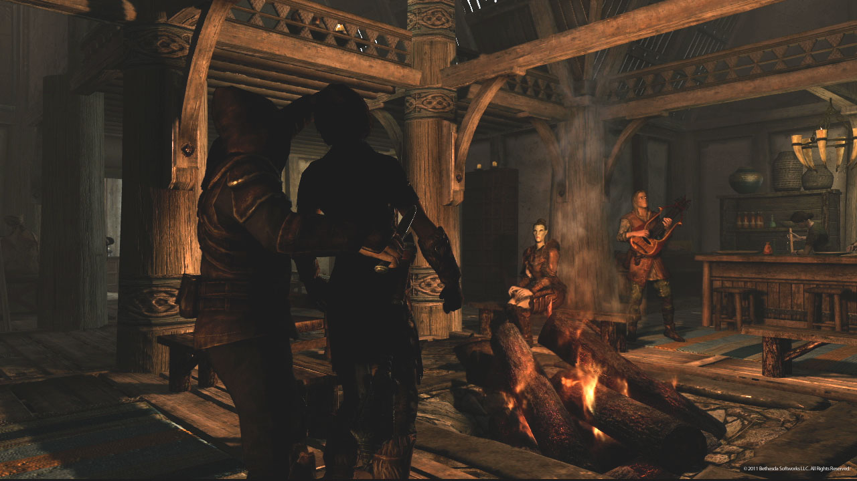

Slide 3
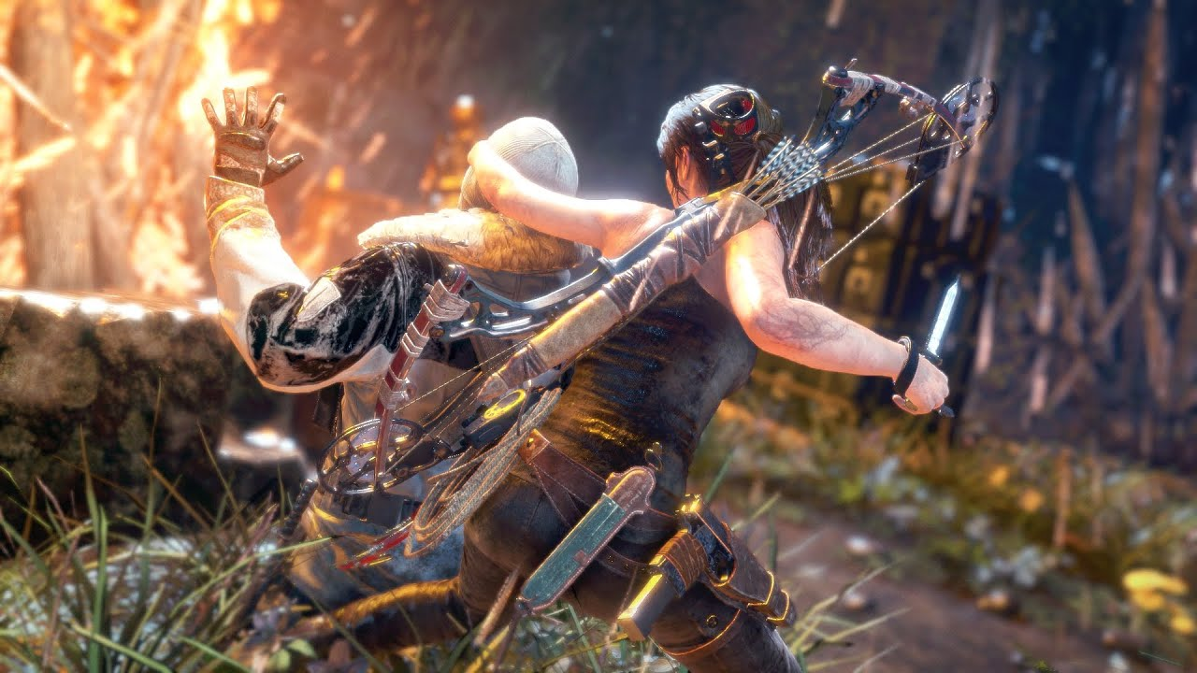

Slide 4


Slide 5


Specs
Goldmaster – P300
15.02.2019
Genre | Stealth-Puzzler
Perspektive | 3D, Isometrie
Engine | Unity
Spieler | 1
Alter | 0+
Plattform | PC
Input | Tastatur, Controller

Slide 6
[GAMEPLAY]

Slide 7
The Product
Goldmaster – P300
15.02.2019
8 Challenges
1 Level
6 Enemies
2 + 1 Abilities (5 Contexts)
= Stable basis for more content

Slide 8
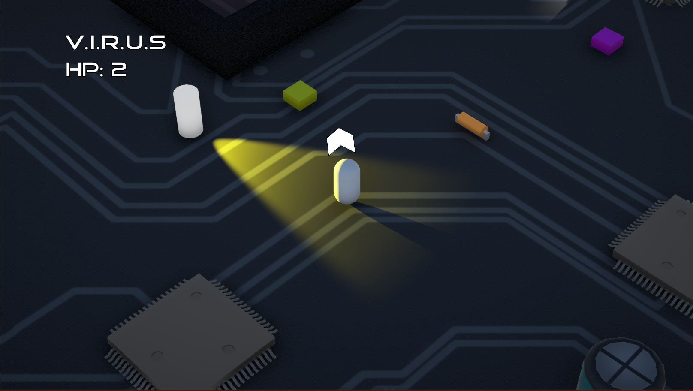
The Pitch
Goldmaster – P300
15.02.2019

Slide 9
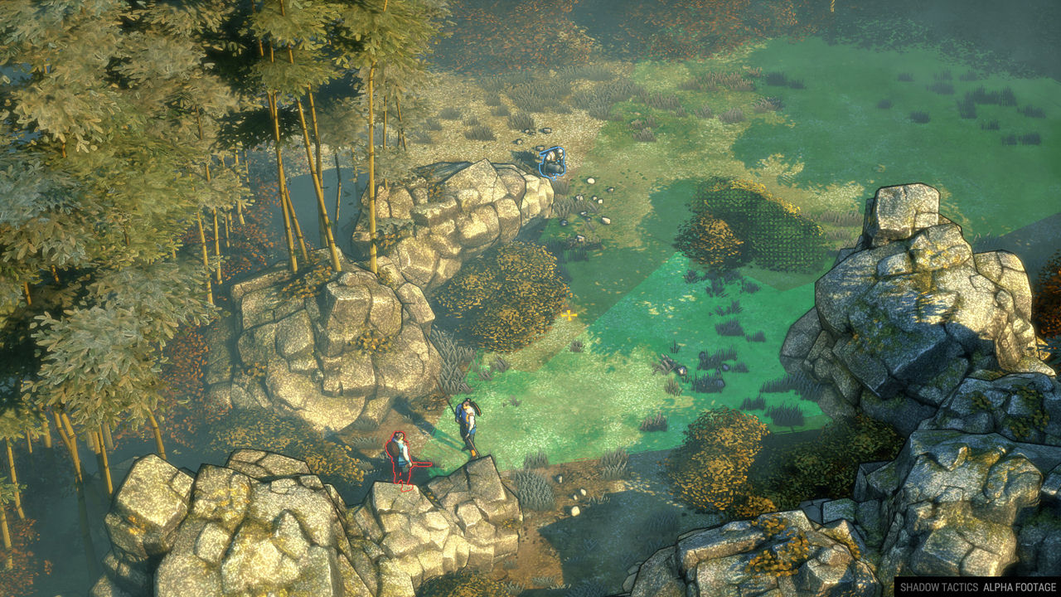
References
Goldmaster – P300
15.02.2019

Slide 10
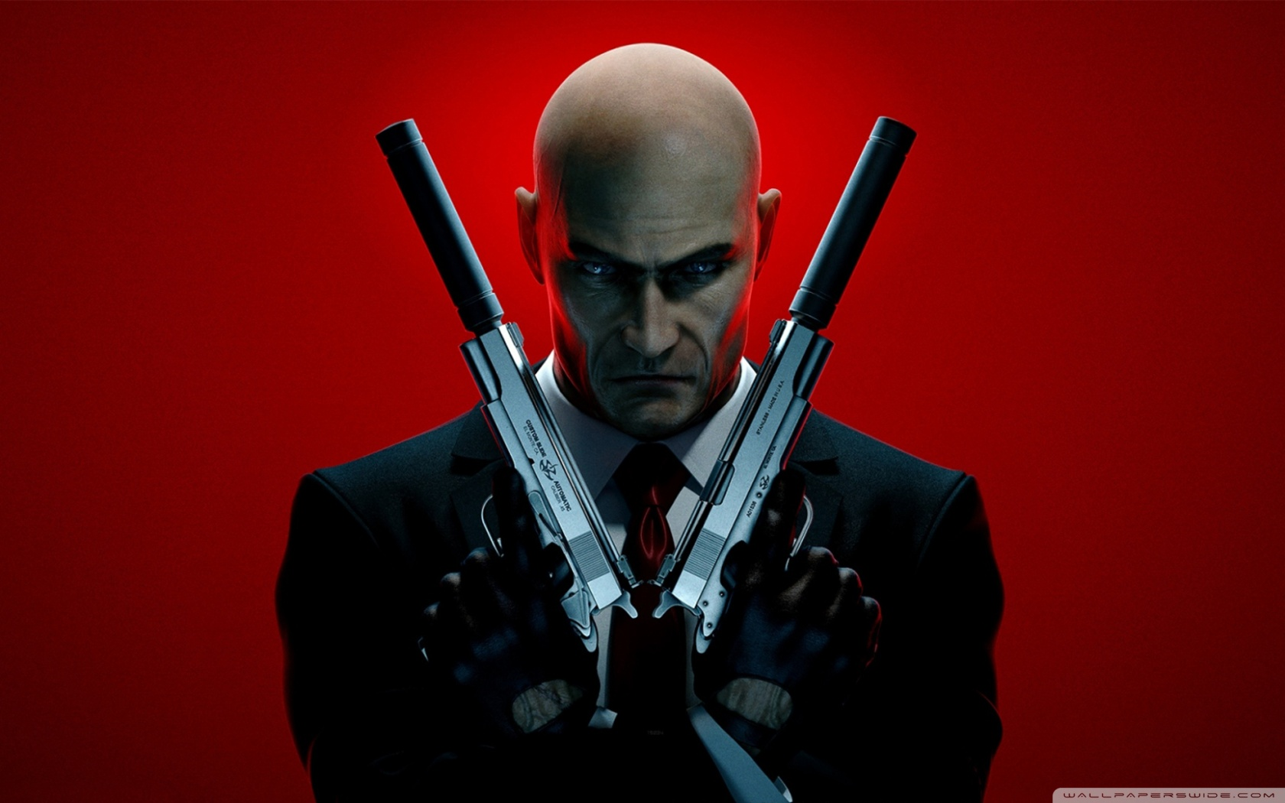
References
Goldmaster – P300
15.02.2019

Slide 11
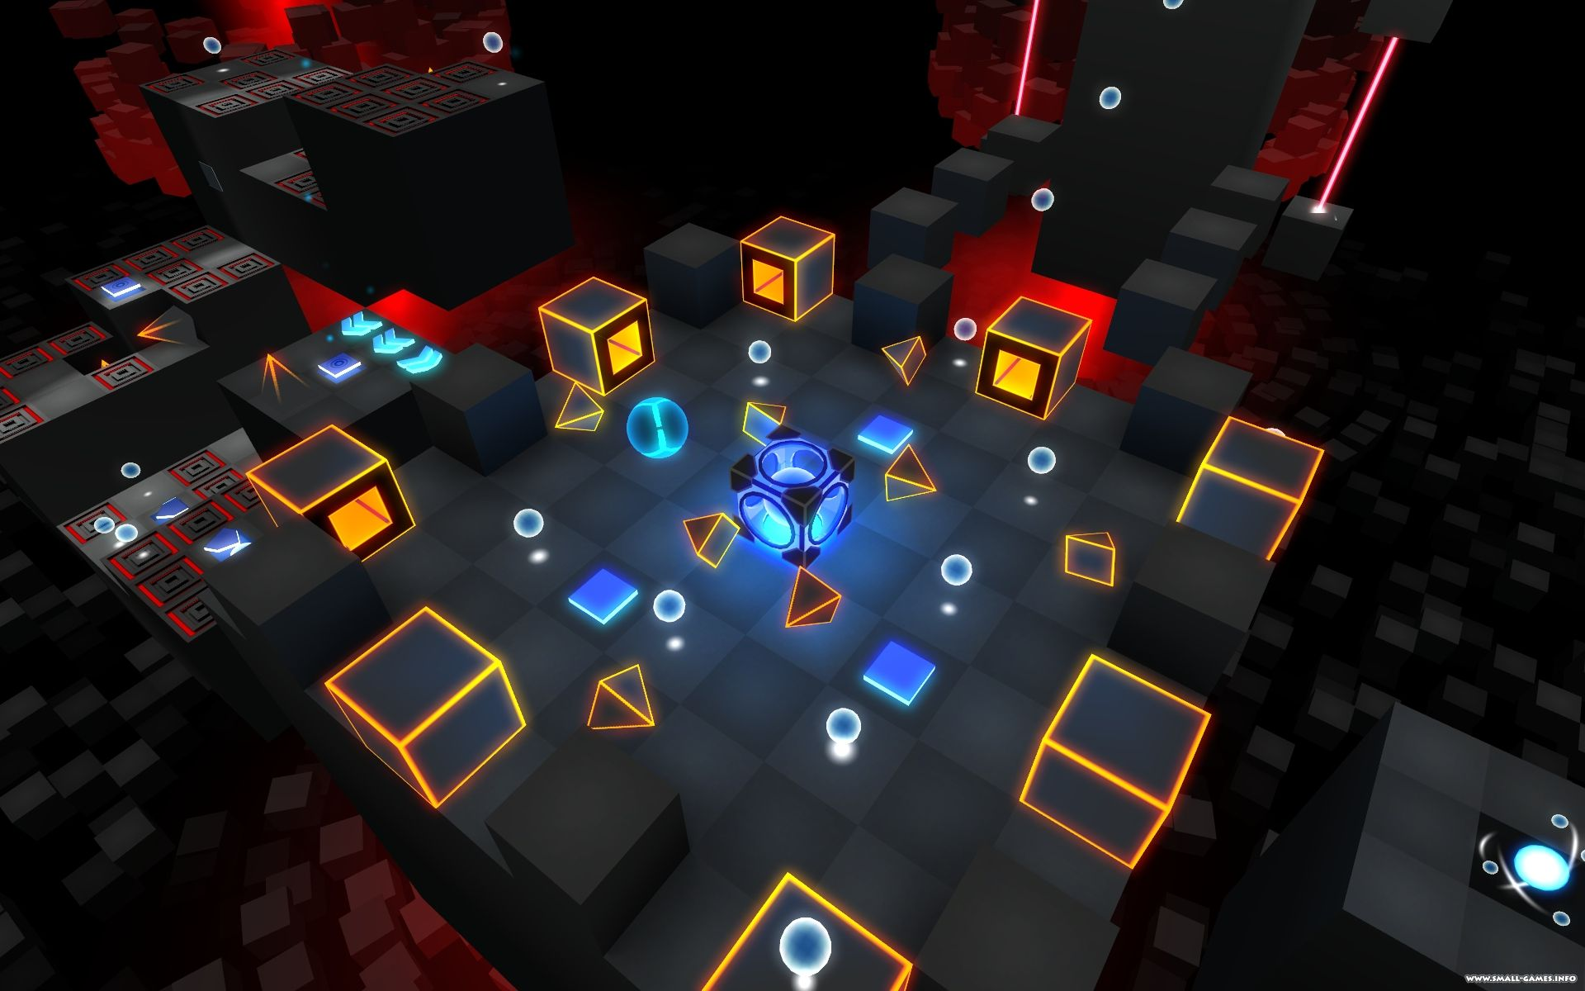
References
Goldmaster – P300
15.02.2019

Slide 12
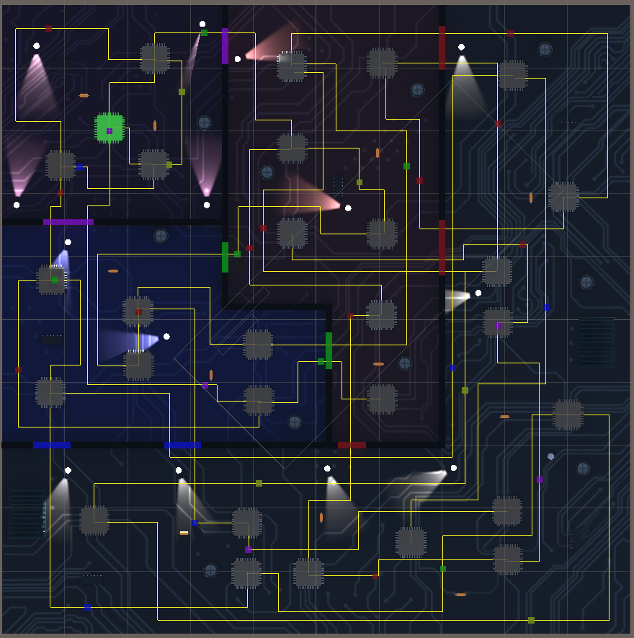
The Vision
Goldmaster – P300
15.02.2019

Slide 13
The Vision
Goldmaster – P300
15.02.2019
1 Tutorial + scenarios
1 Level
4 Enemies
3-4 Abilities (12-16 contexts)
= Too much!

Slide 14
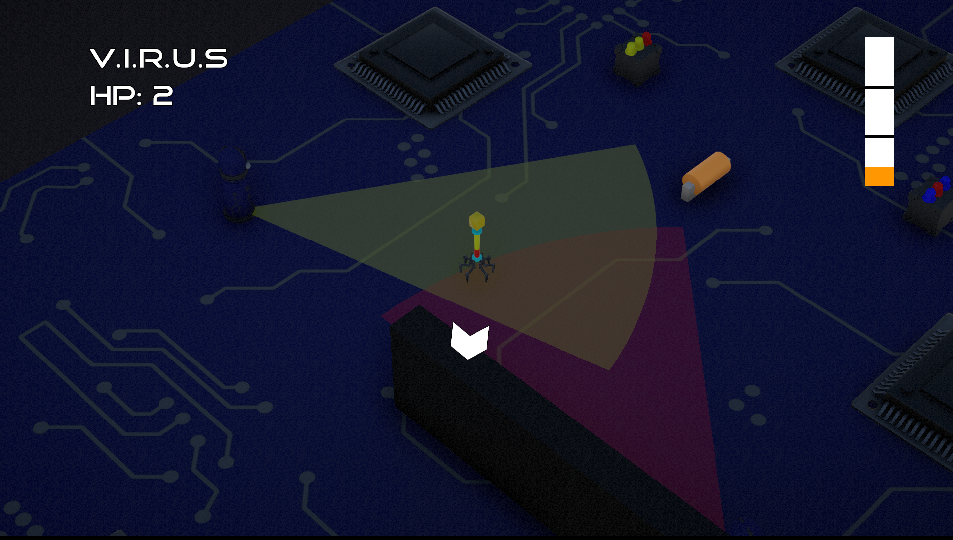
Gate I
Goldmaster – P300
15.02.2019

Slide 15
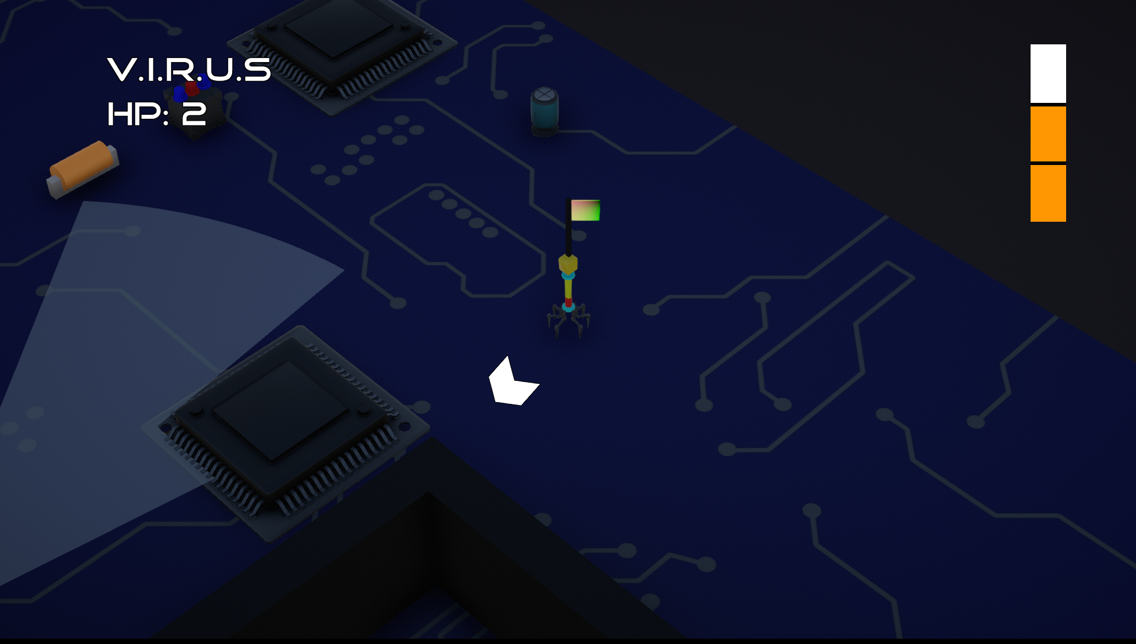
Gate I
Goldmaster – P300
15.02.2019

Slide 16
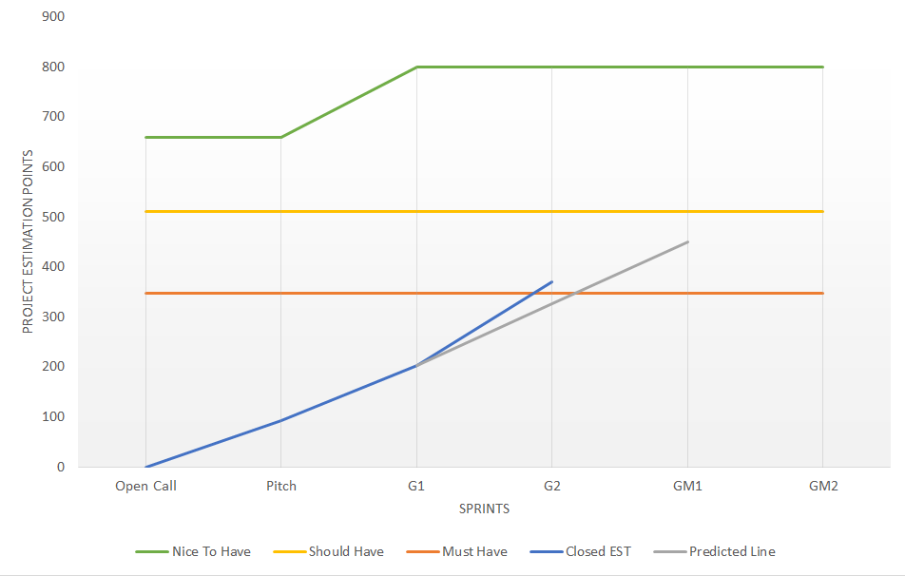
Gate II
Goldmaster – P300
15.02.2019

Slide 17
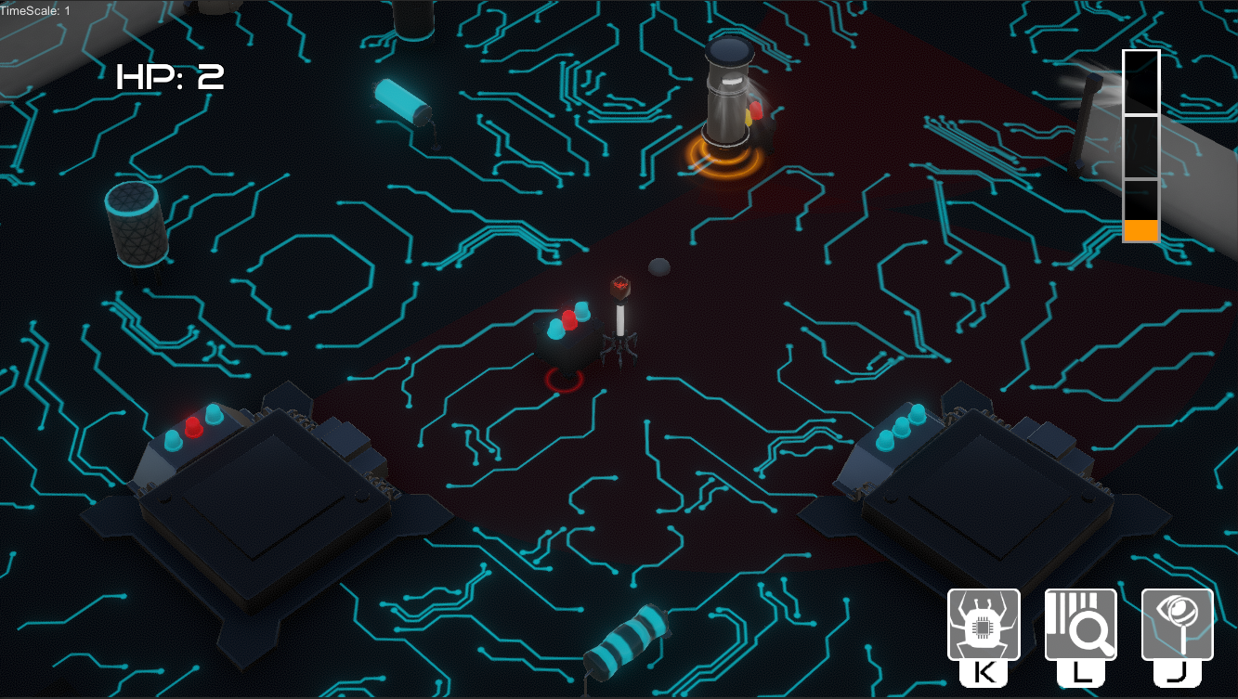
Gate II
Goldmaster – P300
15.02.2019

Slide 18
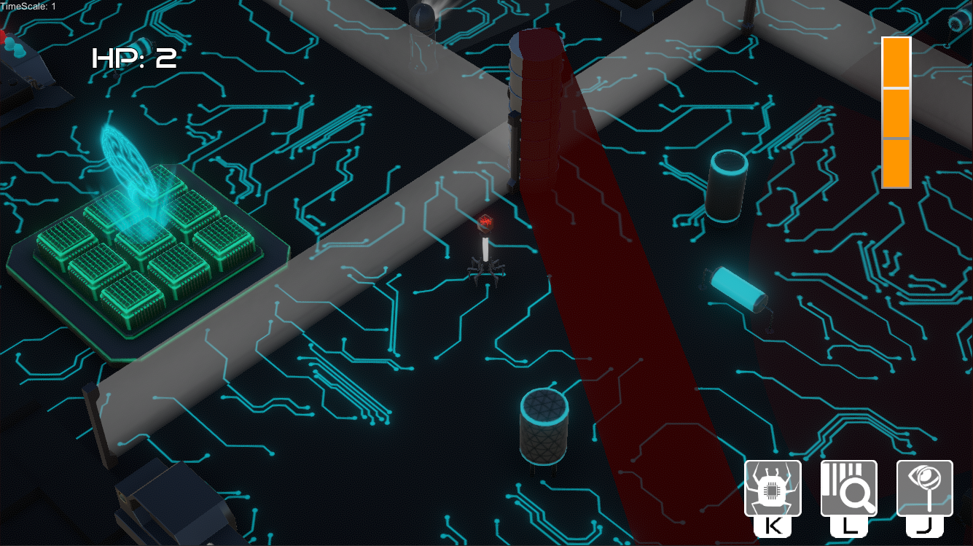
Gate II
Goldmaster – P300
15.02.2019

Slide 19
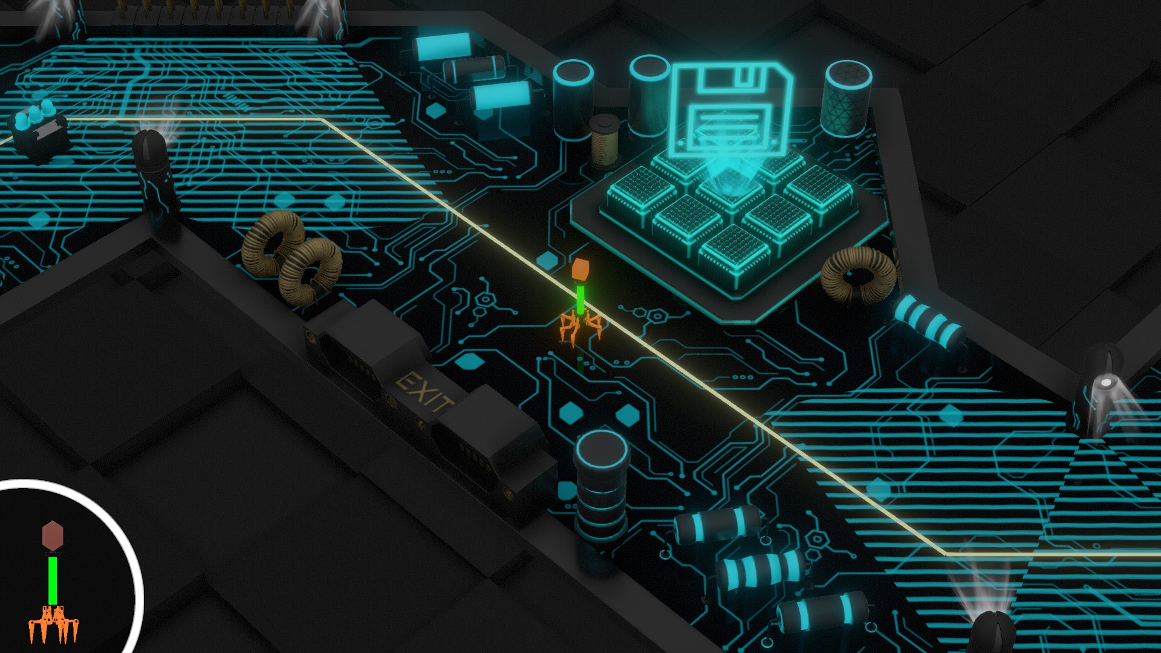
Goldmaster
Goldmaster – P300
15.02.2019

Slide 20
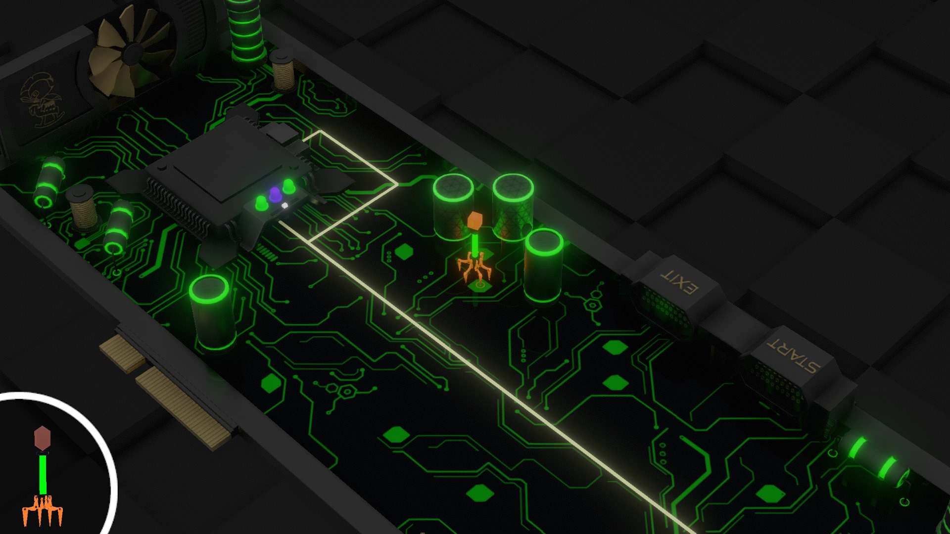
Goldmaster
Goldmaster – P300
15.02.2019

Slide 21
Gate Goals
Goldmaster – P300
15.02.2019
THE GAME
3+ levels polished
Visuals finished
Polished menu structure
UX!
Sound + SFX
Done
Goal changed
Done
Done
Done
Done

Slide 22
Goals GP + GD
Goldmaster – P300
15.02.2019
Felix
Adapt management
Prepare documentation
Goldmaster deliverables
Andreas
Challenges for core mechanics
Mechanic finetuning
Level iteration + QA
Done
Done
Done
Done
Done
Done

Slide 23
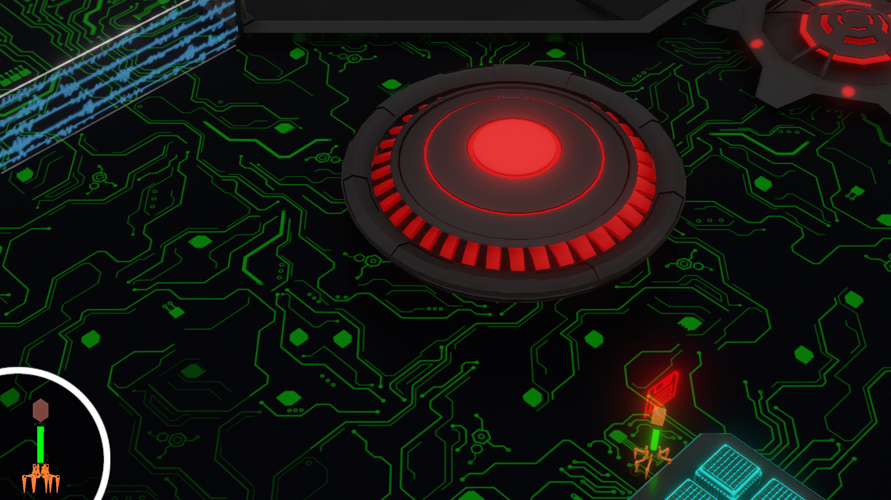
Goals PRO
Goldmaster – P300
15.02.2019
Hunter

Slide 24
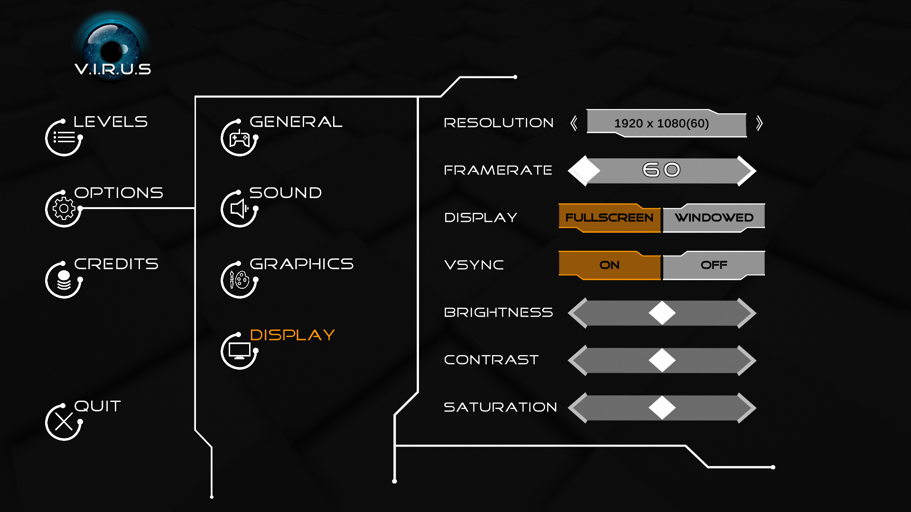
Goals PRO
Goldmaster – P300
15.02.2019
Menus + GUI

Slide 25
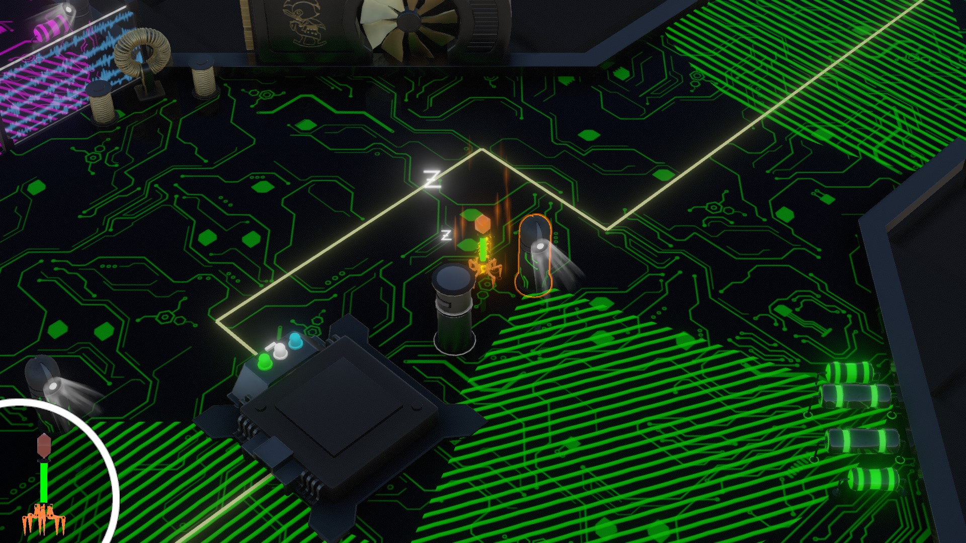
Goals ART
Goldmaster – P300
15.02.2019
Ability VFX

Slide 26







Goals ART
Goldmaster – P300
15.02.2019
GUI Elements + Cover etc.

Slide 27
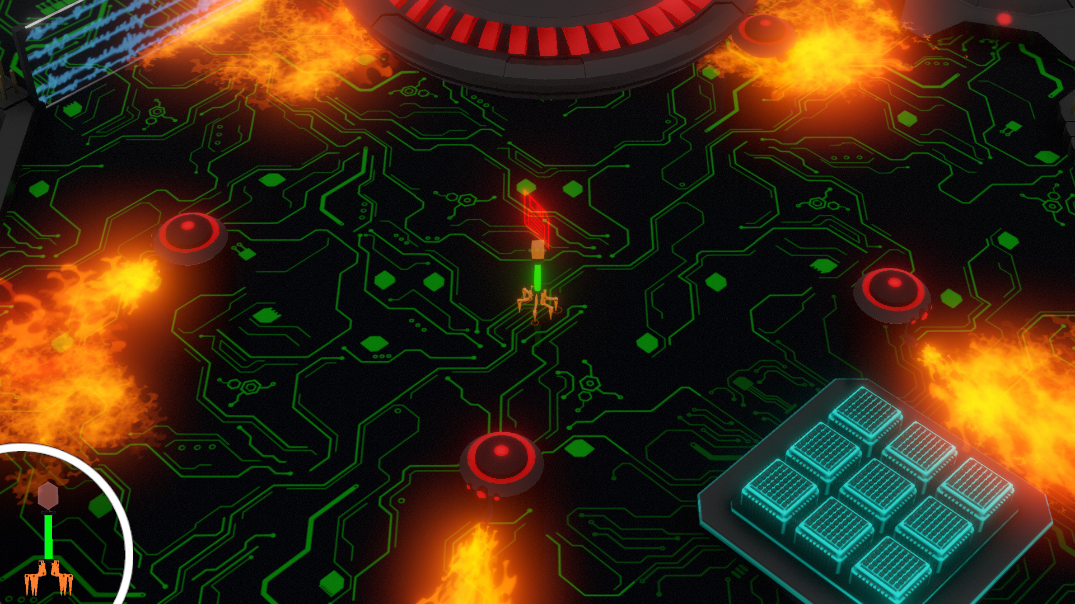
Goals ART
Goldmaster – P300
15.02.2019
Hunter

Slide 28
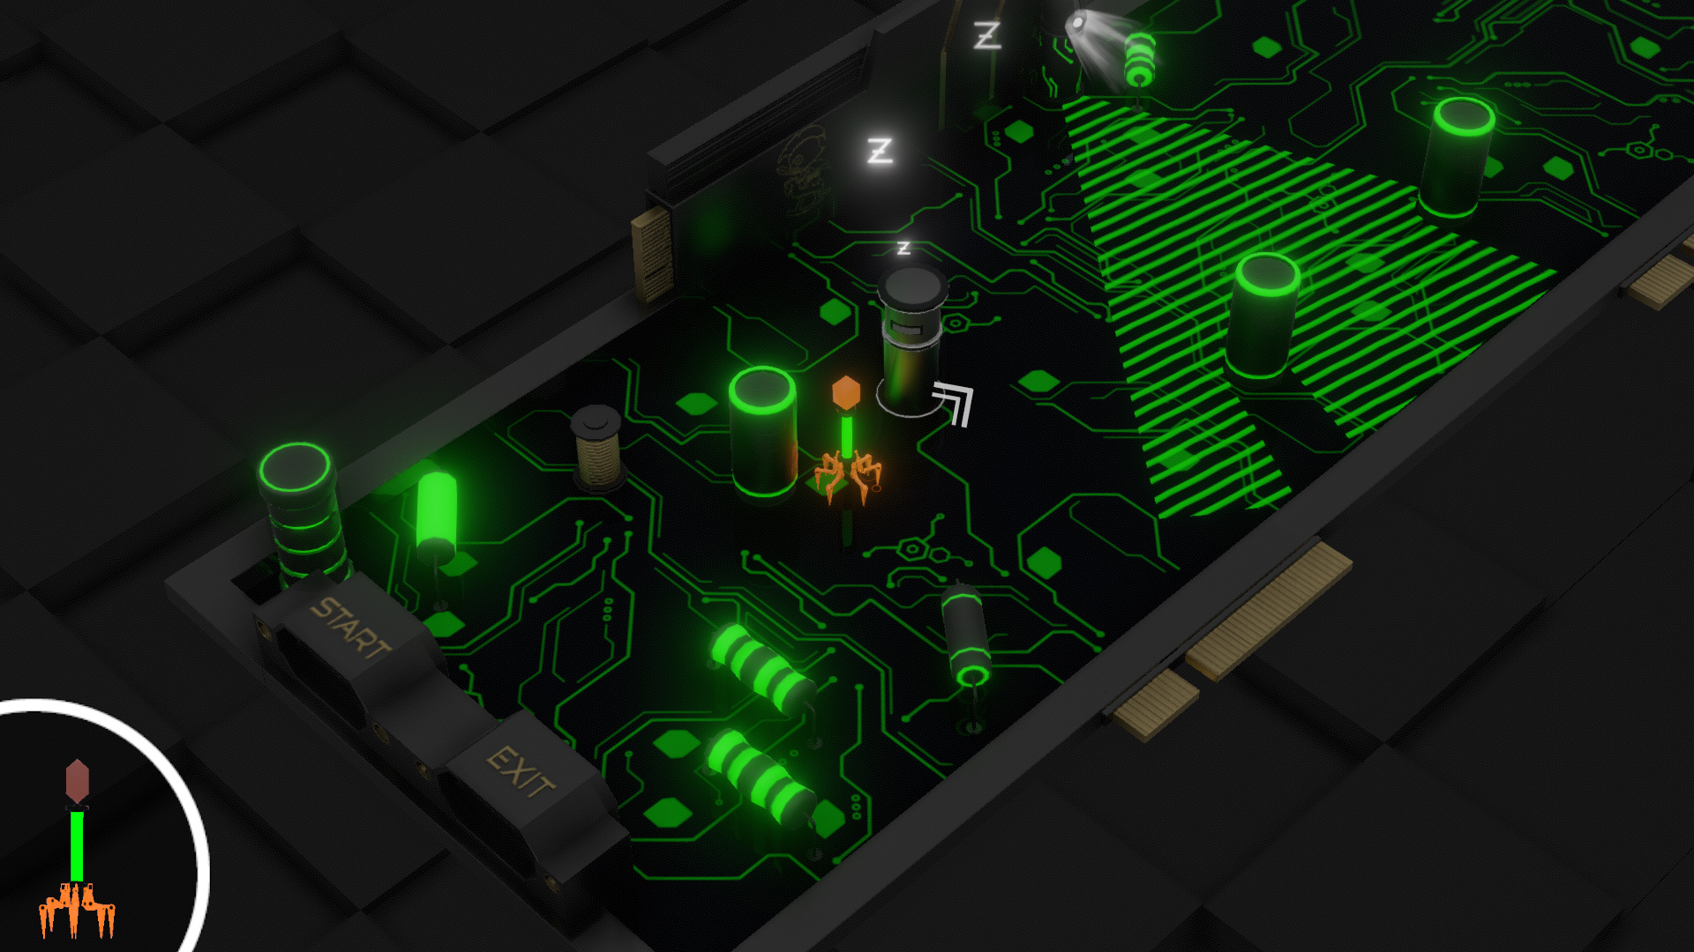
Goals ART
Goldmaster – P300
15.02.2019
Level Styling

Slide 29
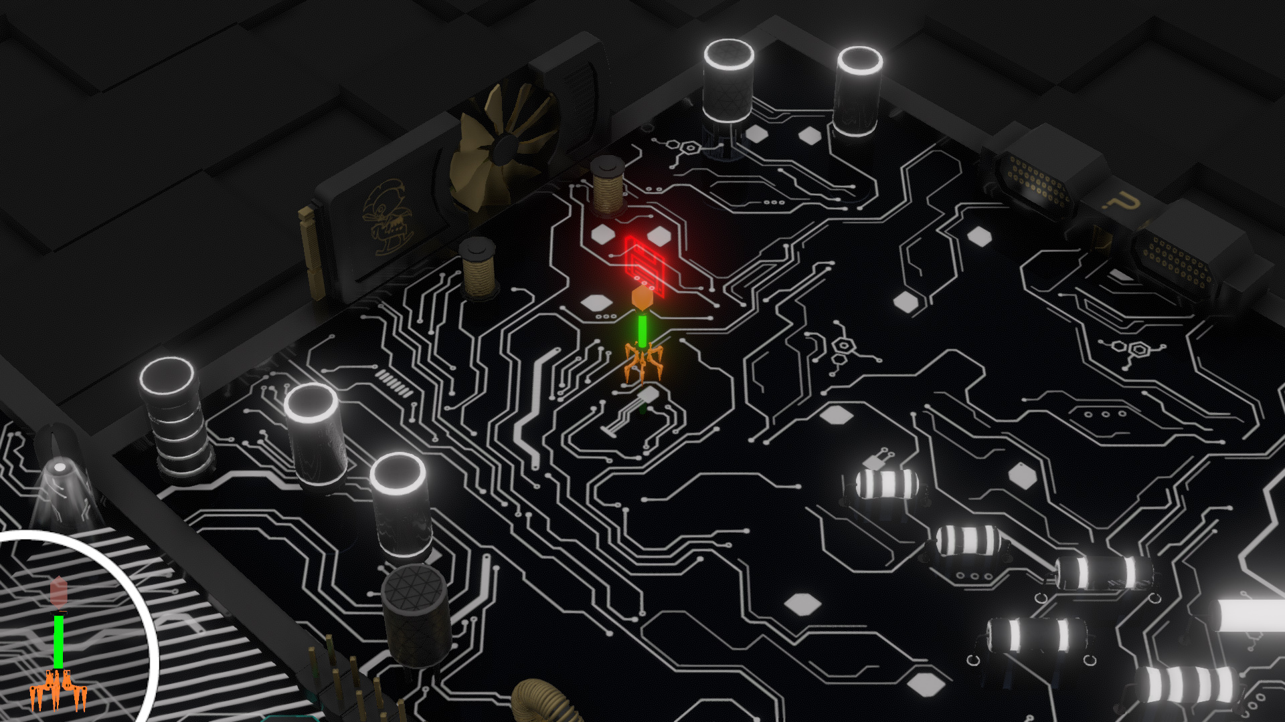
Goals ART
Goldmaster – P300
15.02.2019
Props + Texture Finish

Slide 30
Key Learnings
Goldmaster – P300
15.02.2019
The framework serves the team. If it doesn’t work, let it die.
Just because an idea sounds nice, it doesn’t mean it works out.
Cutting features can be good, even if it hurts.
Ticket systems can be your best friend in later production phases.
1.300 Man-hours are less than you think.

Slide 31





Team
Goldmaster – P300
15.02.2019
Felix Günther
Andreas Edmeier
Nils Hausfeld
Franziska Migge
Silvia Schnitzer
Marcel Jacob
Hanna Kopel
Anna Magdalino

Slide 32

Thank you!
Goldmaster – P300
15.02.2019

